Slide 1
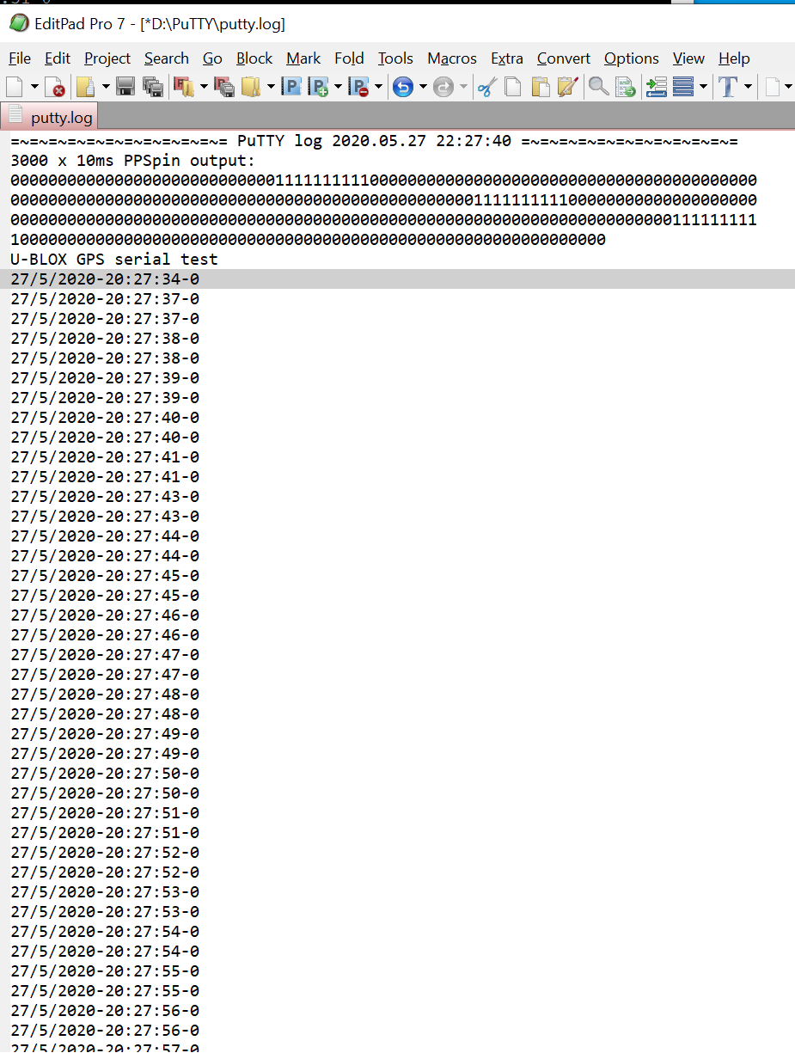
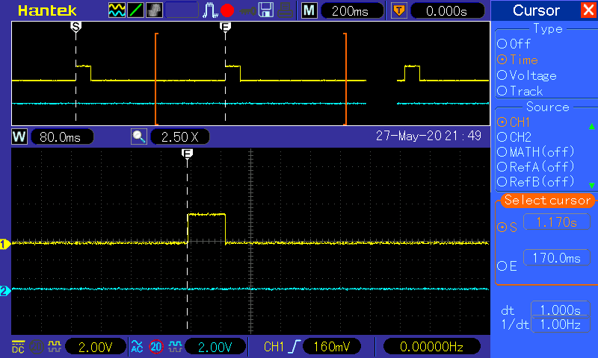
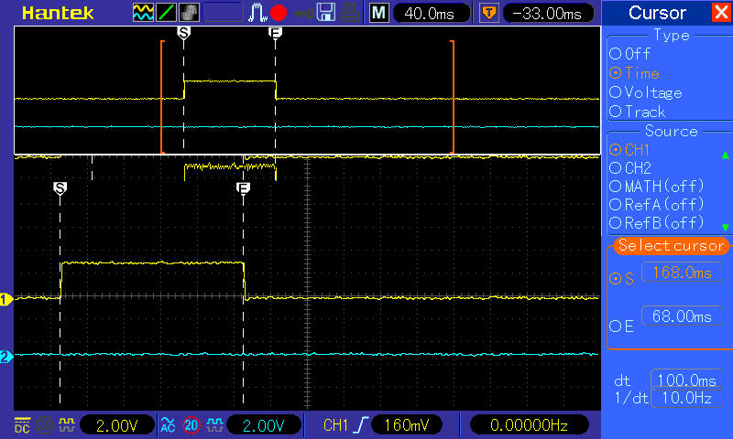
PPS of 100ms
is seen 10x10ms
Modification PCB :
gpio 9 and 10
aren’t free with DIO..
So Tx-GPS was placed at ESP-RX1 …GPS module needs to be removed before programming! ESP-TX was used for terminal debug (9600baud)
This gives the repeating error:
(putty at Tx and GPS at Rx)
PPS pulse of GPS: duration 100ms

